Slide 1
Operating System Vulnerabilities

Slide 2
Objectives
Tools to assess Microsoft system vulnerabilities
Describe the vulnerabilities of Microsoft operating systems and services
Techniques to harden Microsoft systems against common vulnerabilities
Best practices for securing Microsoft systems

Slide 3
Tools to Identify Vulnerabilities on Microsoft Systems
Many tools are available for this task
  Using more than one tool is advisable
Using several tools help you pinpoint problems more accurately

Slide 4
Built-in Microsoft Tools
Microsoft Baseline Security Analyzer (MBSA)
Winfingerprint
HFNetChk

Slide 5
Microsoft Baseline Security Analyzer (MBSA)
Effective tool that checks for
  Patches
  Security updates
  Configuration errors
  Blank or weak passwords
  Others
MBSA supports remote scanning
  Associated product must be installed on scanned computer

Slide 6
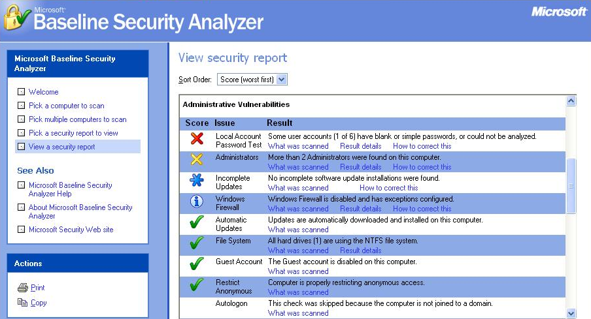
MBSA Results

Slide 7
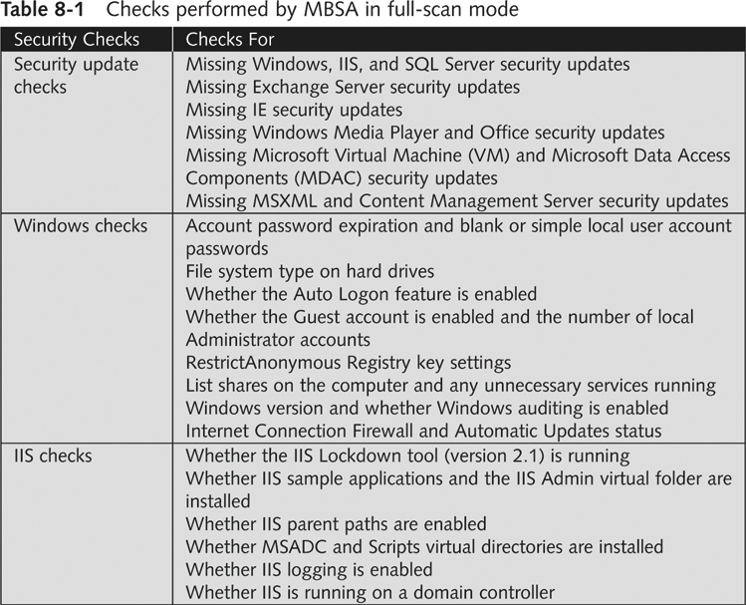

Slide 8
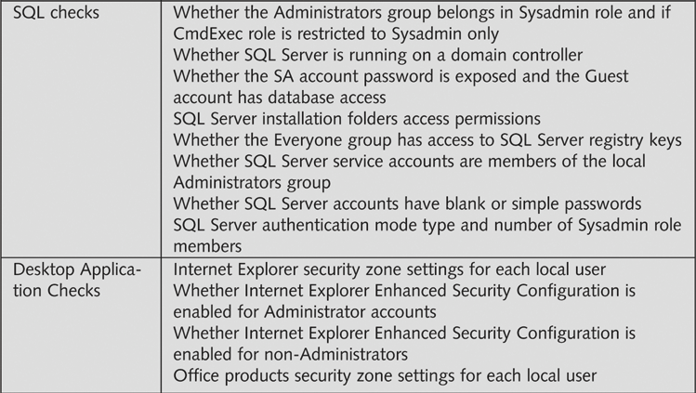

Slide 9
MBSA Versions
2.x for Win 2000 or later & Office XP or later
1.2.1 if you have older products
After installing, MBSA can
  Scan the local machine
  Scan other computers remotely
  Be scanned remotely over the Internet

Slide 10
HFNetChk
HFNetChk is part of MBSA
  Available separately from Shavlik Technologies
  Can be used to control the scanning more precisely, from the command line

Slide 11
Winfingerprint
Administrative tool
It can be used to scan network resources
Exploits Windows null sessions
Detects
  NetBIOS shares
  Disk information and services
  Null sessions

Slide 12
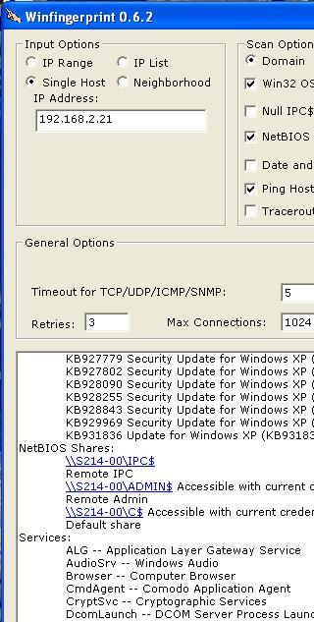
Winfingerprint
Can find
  OS detection
  Service packs and hotfixes
  Running Services
  See Proj X6 for Details

Slide 13
Microsoft OS Vulnerabilities
Microsoft integrates many of its products into a single package
  Such as Internet Explorer and Windows OS
  This creates many useful features
  It also creates vulnerabilities
Security testers should search for vulnerabilities on
  The OS they are testing
  Any application running on the server

Slide 14

CVE (Common Vulnerabilities and Exposures )
A list of standardized names for vulnerabilities
Makes it easier to share information about them
  cve.mitre.org (link Ch 8c)
  Demonstration: Search

Slide 15
Remote Procedure Call (RPC)
RPC is an interprocess communication mechanism
  Allows a program running on one host to run code on a remote host
Examples of worms that exploited RPC
  MSBlast (LovSAN, Blaster)
  Nachi
Use MBSA to detect if a computer is vulnerable to an RPC-related issue

Slide 16
NetBIOS
Software loaded into memory
  Enables a computer program to interact with a network resource or other device
NetBIOS is not a protocol
  NetBIOS is an interface to a network protocol
  It’s sometimes called a session-layer protocol, or a protocol suite (Links Ch 8d, 8e, 8f)

Slide 17
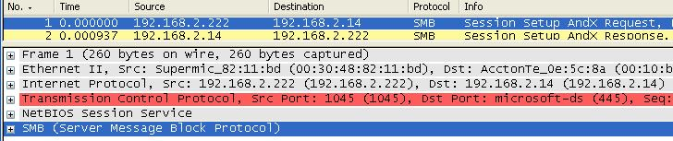
NetBEUI
NetBIOS Extended User Interface
  Fast, efficient network protocol
  Allows NetBIOS packets to be transmitted over TCP/IP
  NBT is NetBIOS over TCP

Slide 18
NetBIOS (continued)
Newer Microsoft OSs do not need NetBIOS to share resources
  NetBIOS is used for backward compatibility
  You can turn off NetBIOS for Windows 2000 and later (links Ch 8g & 8h)

Slide 19
Server Message Block (SMB)
Used by Windows 95, 98 and NT to share files
Usually runs on top of NetBIOS, NetBEUI or TCP/IP
Hacking tools
  L0phtcrack’s SMB Packet Capture utility
  SMBRelay
  Ettercap (see Project 23, Links Ch 8r & 8s)

Slide 20
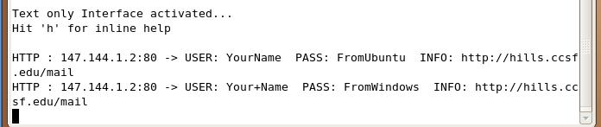

Demonstration: ettercap

Slide 21
Common Internet File System (CIFS)
CIFS replaced SMB for Windows 2000, XP, and Windows 2003 Server
  SMB is still used for backward compatibility
CIFS is a remote file system protocol
  Enables computers to share network resources over the Internet

Slide 22
Common Internet File System (CIFS) (continued)
Enhancements over SMB
  Resource locking (if 2 people use the same thing at once)
  Support for fault tolerance
  Capability to run more efficiently over dial-up
  Support for anonymous and authenticated access

Slide 23
Common Internet File System (CIFS) (continued)
Server security methods
  Share-level security
    A password assigned to a shared resource
  User-level security
    An access control list assigned to a shared resource
    Users must be on the list to gain access
  Passwords are stored in an encrypted form on the server
But CIFS is still vulnerable (see link Ch 8n)
  Don’t let NetBIOS traffic past the firewall

Slide 24
Understanding Samba
Open-source implementation of CIFS
  Created in 1992
Samba allows sharing resources over multiple OSs
Samba accessing Microsoft shares can make a network susceptible to attack
Samba is used to “trick” Microsoft services into believing the *NIX resources are Microsoft resources

Slide 25

Samba is Built into Ubuntu
Click Places, Connect to Server
  Windows shares are marked with SMB

Slide 26
Closing SMB Ports
Best way to protect a network from SMB attacks
  Routers should filter out ports
    137 to 139
    445

Slide 27
Default Installations
Windows 9x, NT, and 2000 all start out with many services running and ports open
  They are very insecure until you lock them down
Win XP, 2003, and Vista are much more secure by default
  Services are blocked until you open them

Slide 28
Passwords and Authentication
A comprehensive password policy is critical
  Change password regularly
  Require passwords length of at least six characters
  Require complex passwords
  Never write a password down or store it online or on the local system
  Do not reveal a password over the phone

Slide 29
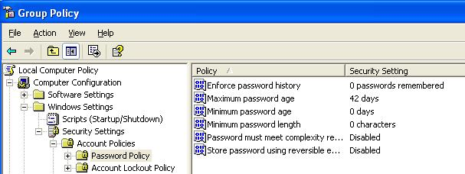
Passwords and Authentication
Configure domain controllers
  Enforce password age, length and complexity
  Account lockout threshold
  Account lockout duration
    Start, Run, GPEDIT.MSC

Slide 30
IIS (Internet Information Services)
IIS 5 and earlier installs with critical security vulnerabilities
  Run IIS Lockdown Wizard (link Ch 8p)
IIS 6.0 installs with a “secure by default” posture
  Configure only services that are needed
  Windows 2000 ships with IIS installed by default
  Running MBSA can detect IIS running on your network

Slide 31
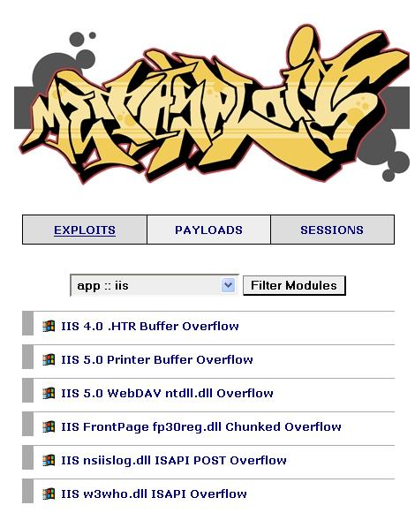
IIS Buffer Overflows

Slide 32
SQL Server
SQL vulnerabilities exploits areas
  The SA account with a blank password
  SQL Server Agent
  Buffer overflow
  Extended stored procedures
  Default SQL port 1433
Vulnerabilities related to SQL Server 7.0 and SQL Server 2000

Slide 33
The SA Account
The SA account is the master account, with full rights
SQL Server 6.5 and 7 installations do not require setting a password for this account
SQL Server 2000 supports mixed-mode authentication
  SA account is created with a blank password
  SA account cannot be disabled

Slide 34
SQL Server Agent
Service mainly responsible for
  Replication
  Running scheduled jobs
  Restarting the SQL service
Authorized but unprivileged user can create scheduled jobs to be run by the agent

Slide 35
Buffer Overflow
Database Consistency Checker in SQL Server 2000
  Contains commands with buffer overflows
SQL Server 7 and 2000 have functions that generate text messages
  They do not check that messages fit in the buffers supplied to hold them
Format string vulnerability in the C runtime functions

Slide 36
Extended Stored Procedures
Several of the extended stored procedures fail to perform input validation
  They are susceptible to buffer overruns

Slide 37
Default SQL Port 1443
SQL Server is a Winsock application
  Communicates over TCP/IP using port 1443
Spida worm
  Scans for systems listening on TCP port 1443
  Once connected, attempts to use the xp_cmdshell
    Enables and sets a password for the Guest account
Changing default port is not an easy task

Slide 38
Best Practices for Hardening Microsoft Systems
Penetration tester
  Finds vulnerabilities
Security tester
  Finds vulnerabilities
  Gives recommendations for correcting found vulnerabilities

Slide 39
Patching Systems
The number-one way to keep your system secure
  Attacks take advantage of known vulnerabilities
  Options for small networks
    Accessing Windows Update manually
    Automatic Updates
  This technique does not really ensure that all machines are patched at the same time
  Does not let you skip patches you don’t want

Slide 40
Patching Systems
Some patches cause problems, so they should be tested first
Options for patch management for large networks
  Systems Management Server (SMS)
  Software Update Service (SUS)
Patches are pushed out from the network server after they have been tested

Slide 41
Antivirus Solutions
An antivirus solution is essential
For small networks
  Desktop antivirus tool with automatic updates
For large networks
  Corporate-level solution
An antivirus tool is almost useless if it is not updated regularly

Slide 42
Enable Logging and Review Logs Regularly
Important step for monitoring critical areas
  Performance
  Traffic patterns
  Possible security breaches
Logging can have negative impact on performance
Review logs regularly for signs of intrusion or other problems
  Use a log-monitoring tool

Slide 43
Disable Unused or Unneeded Services
Disable unneeded services
Delete unnecessary applications or scripts
Unused applications or services are an invitation for attacks
Requires careful planning
  Close unused ports but maintain functionality

Slide 44
Other Security Best Practices
  Use a firewall on each machine, and also a firewall protecting the whole LAN from the Internet
  Delete unused scripts and sample applications
  Delete default hidden shares
  Use different names and passwords for public interfaces

Slide 45
Other Security Best Practices
  Be careful of default permissions
    For example, new shares are readable by all users in Win XP
  Use available tools to assess system security
    Like MBSA, IIS Lockdown Wizard, etc.
  Disable the Guest account
  Rename the default Administrator account
  Enforce a good password policy
  Educate users about security
  Keep informed about current threats

